Slide 1




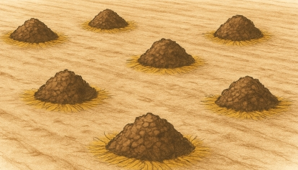

P1
P2
P3
S1
S2
S3

Slide 2
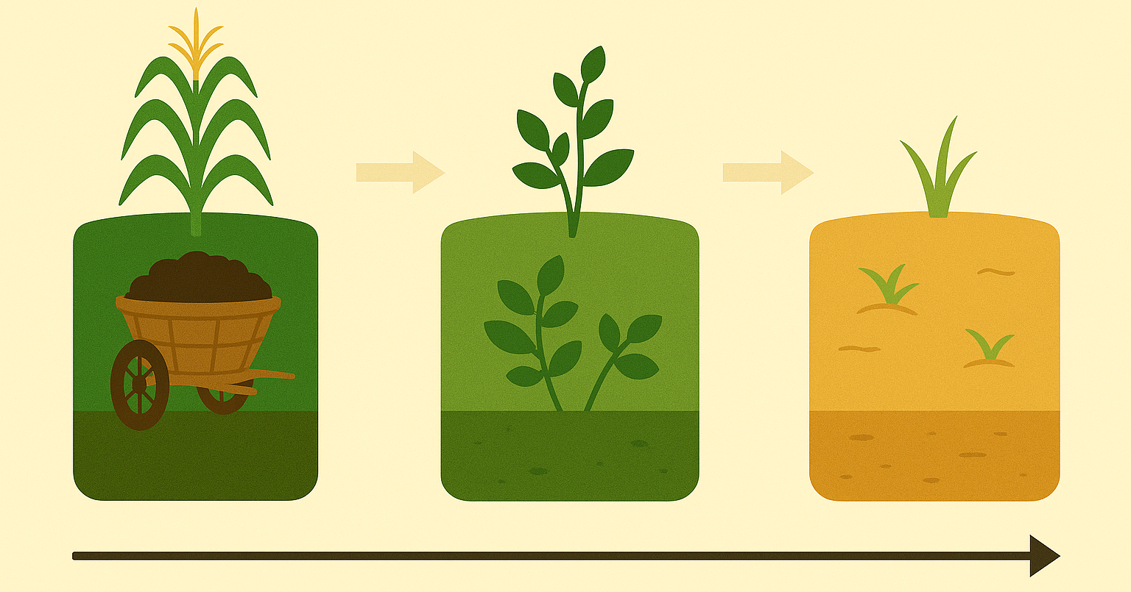
S1
S2
S3

Slide 3
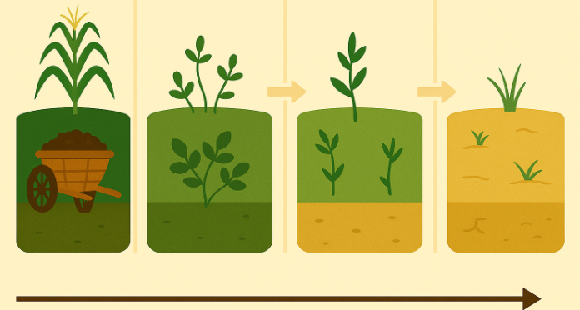
S1
S2
S3
S4

Slide 4
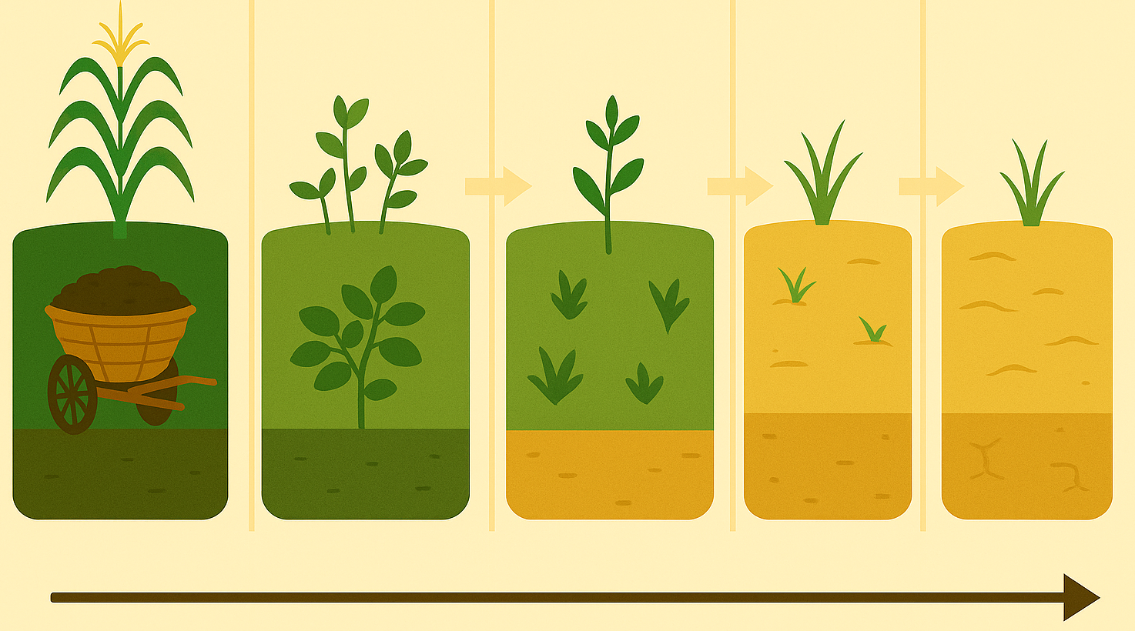
S1
S2
S3
S4
S5

